Slide 1
Resolvers & Upload & Exceptions & Internationalization & Tiles
Harmonizing Diversity

Slide 2
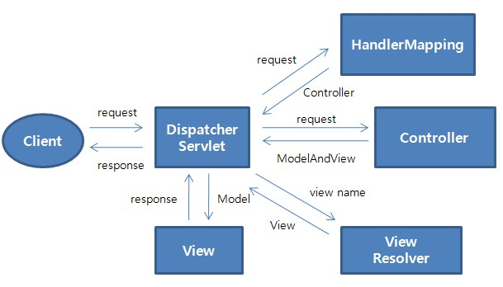
Spring MVC Flow

Slide 3
Spring MVC View Resolvers
Flexible View Resolving Mechanism
Resolve logical String-based view names to View types.
Many out-of-the-box implementations[examples]:
UrlBasedViewResolver-This directly resolves a view name to a URL without any explicit mapping. The view names can be the URL themselves or a prefix or suffix can be added to get the URL from the view name.
InternalResourceViewResolver-This is a subclass of
UrlBasedViewResolver. Out-of-the-box support for JSP
FreeMarkerViewResolver-This is a subclass of UrlBasedViewResolver that supports FreeMarkerView and its subclasses.
VelocityViewResolver-This is a subclass of UrlBasedViewResolver that supports VelocityView and its subclasses.
ContentNegotiatingViewResolver-This is an implementation of a view resolver based on the request file name or Accept header – mime-type. This class delegates view resolution to other view resolvers that are configured.
Notes:
InternalResourceViewResolver - Subclass of UrlBasedViewResolver that supports InternalResourceView. An InternalResourceView wraps JSP or some other resource of the same web app. You can access models in the JSP using EL.
NOTE : Some URLBasedViewResolvers (Tiles, Velocity,Freemarker) check if resource exist and return null. So they can be anywhere in the view resolver chain. Others must be last (JSTL/JSP, XSLT, JSON)
So InternalResourceViewResolver needs to be last in the chain of view resolvers since it resolves view name whether the actual resource is present or not.
Some other URLBasedViewReolver s are
InternalResourceViewResolver
VelocityViewReolver
FreeMarkerViewReolver
ThymeleafViewResolver
XsltViewReolver
https://stackoverflow.com/questions/22721655/some-questions-about-resolving-multiplt-spring-view-resolvers

Slide 4
Multiple View Resolvers Configuration
<!-- lower order value has a higher priority -->
<bean class="org.springframework.web.servlet.view.InternalResourceViewResolver">
<property name="prefix" value="/WEB-INF/views/" />
<property name="order" value="4" />
</bean>
<bean class="org.thymeleaf.spring4.view.ThymeleafViewResolver">
<property name="templateEngine" ref="templateEngine" />
<property name="viewNames" value="*.html" />
<property name="order" value="3" />
</bean>
<bean id="viewResolver"
class="org.springframework.web.servlet.view.freemarker.FreeMarkerViewResolver">
<property name="cache" value="true" />
<property name="prefix" value="" />
<property name="suffix" value=".ftl" />
<property name="order" value="2" />
</bean>

Slide 5
Spring MVC Views
Spring has flexible view support through the View Interface class
Out-of-the-box view support for:
  JspView - InternalResourceViewResolver
  JSON - ContentNegotiatingViewResolver **
  XML - ContentNegotiatingViewResolver **
  PDF - ContentNegotiatingViewResolver **
  Excel - ContentNegotiatingViewResolver **
  Tiles - TilesViewResolver
  Velocity - VelocityViewResolver
  FreeMarker - FreeMarkerViewResolver
  Redirect - InternalResourceViewResolver
  Forward - InternalResourceViewResolver
The ContentNegotiatingViewResolver determines which view resolver to use based on file extension. Foo.json.vs.Foo.xml.vs.Foo.pdf…
[or by URL parameter specifying type of output format or accept header]
** “Candidates”
Notes:
issue with the Accept header - impossible to set it in a web browser - in Firefox, it is fixed
Accept: text/html,application/xhtml+xml,application/xml;q=0.9,*/*;q=0.8
For this reason it is common to see the use of a distinct URI for each representation
By default PathExtensionContentNegotiationStrategy is consulted (which uses the URL extension e.g. .xls, .pdf,.json..) , followed by ParameterContentNegotiationStrategy (which uses the request parameter ‘format=xls’ e.g.), followed by HeaderContentNegotiationStrategy (which uses HTTP Accept Headers).

Slide 6
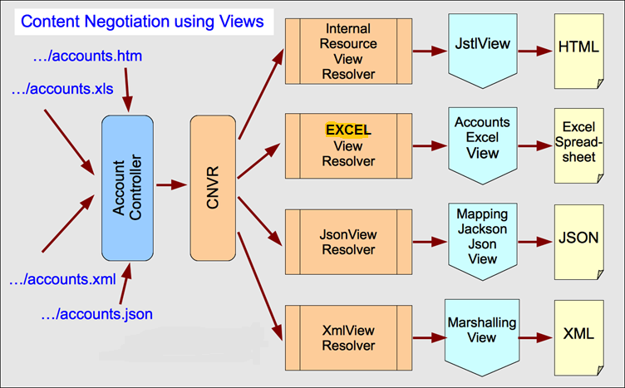
ContentNegotiatingViewResolver
Scenario based on “file extension” in URL:
Single Controller method..multiple views…CNVR

Slide 7
ContentNegotiatingViewResolver
Resolve a view based on the file extension or Accept header of the HTTP request.
GET /api/something?param1=value1
Accept: application/xml (or application/json)
Does not perform the view resolution itself but instead delegates to a list of view resolvers that you specify through the bean property ViewResolvers.

Slide 8
ContentNegotiatingViewResolver
<bean class= "org.springframework.web.servlet.view.ContentNegotiatingViewResolver">
  <property name="defaultViews">
    <list>
      <ref bean="jsonView"/>
      <ref bean="xmlView"/>
    </list>
  </property>
</bean>
<bean id="jsonView"class= "org.springframework.web.servlet.view.json.MappingJacksonJsonView">
  <property name="prettyPrint" value="true"/>
</bean>
Notes:
One of the strengths of the MVC pattern is the ability to have multiple views for the same data.

Slide 9
ContentNegotiatingViewResolver
@Bean
public MappingJackson2JsonView jsonView() {
  MappingJackson2JsonView jsonView = new MappingJackson2JsonView();
  jsonView.setPrettyPrint(true);
  return jsonView;
}
@Bean
public MarshallingView xmlView() {
  Jaxb2Marshaller marshaller = new Jaxb2Marshaller();
  marshaller.setClassesToBeBound(Product.class);
  MarshallingView xmlView = new MarshallingView(marshaller);
  return xmlView;
}
@Bean
public ViewResolver contentNegotiatingViewResolver(ContentNegotiationManager manager) {
  ContentNegotiatingViewResolver resolver = new ContentNegotiatingViewResolver();
  resolver.setContentNegotiationManager(manager);
  List<View> views = new ArrayList<>();
  views.add(jsonView());
  views.add(xmlView());
  resolver.setDefaultViews(views);
  return resolver;
}

Slide 10
Resolving Image files for uploading
HTTP multipart request is used by browsers to upload files/data to the server.
Spring good support HTTP multipart request:
  CommonsMultipartResolver
DispatcherServlet XML/Java config:
<bean id="multipartResolver" class="org.springframework.web.multipart.commons.CommonsMultipartResolver">
<property name="maxUploadSize" value="10240000"/>
</bean>
@Bean
public CommonsMultipartResolver multipartResolver() {
  CommonsMultipartResolver resolver = new CommonsMultipartResolver();
  resolver.setDefaultEncoding("utf-8");
  resolver.setMaxUploadSize(10240000);
  return resolver;
}
Notes:
All files are binary even if they should only contain text. application/x-www-form-urlencoded is the standard way to POST a form without attached files. multipart/form-data is the standard way to POST a form with attached file(s). (There are also numerous other encodings, such as application/json
HTTP HEADER _ Content-Type: multipart/form-data;

Slide 11
Resolving Image files for uploading[Cont.]
JSP configuration
<form:form modelAttribute="newProduct" class="form-horizontal" enctype="multipart/form-data">
  <div class="form-group">
    <label class="control-label col-lg-2" for="productImage">
      <spring:message code="addProduct.form.productImage.label" />
    </label>
    <div class="col-lg-10">
      <form:input path="productImage" id="productImage"
      type="file" class="form:input-large" />
    </div>
  </div>
</form:form>
Content-Type: multipart/form-data
Notes:
https://www.w3schools.com/tags/att_form_enctype.asp
The enctype attribute specifies how the form-data should be encoded when submitting it to the server.
Note: The enctype attribute can be used only if method="post".
application/x-www-form-urlencoded:
Default. All characters are encoded before sent (spaces are converted to "+" symbols, and special characters are converted to ASCII HEX values)
multipart/form-data:
No characters are encoded. This value is required when you are using forms that have a file upload control
text/plain:
Spaces are converted to "+" symbols, but no special characters are encoded

Slide 12
Resolving Image files for uploading [Cont.]
@XmlRootElement
public class Product implements Serializable {
  @Pattern(regexp = "P[1-9]+", message = "{Pattern.Product.productId.validation}")
  @ProductId
  private String productId;
  @Size(min = 4, max = 50, message = "{Size.Product.name.validation}")
  private String name;
  @JsonIgnore
  private MultipartFile productImage;
}

Slide 13
Resolving Image files for uploading[Cont.]
Saving image in Controller:
@RequestMapping(method = RequestMethod.POST)
public String processAddNewProductForm(@Valid @ModelAttribute("newProduct") Product newProduct,
BindingResult result, Model model, HttpServletRequest request) {
  MultipartFile productImage = newProduct.getProductImage();
  String rootDirectory = request.getSession().getServletContext().getRealPath("/");
  if (productImage != null && !productImage.isEmpty()) {
    try {
      productImage.transferTo(
      new File(rootDirectory + "resources\\images\\" + newProduct.getProductId() + ".png"));
    } catch (Exception e) {
    throw new RuntimeException("Product Image saving failed", e);
    }
  }
  productService.addProduct(newProduct);
  return "redirect:/products";
}
Notes:
Why RedirectAttributes not used here?

Slide 14
Main Point
Spring MVC Views and View Resolvers offers a variety of ways to manage the presentation of data.
Life is the expression of the field of all possibilities resulting in a veritable explosion of variety in nature

Slide 15
Handler Exception Resolver
HandlerExceptionResolver interface
    Used to resolve exceptions during Controller mapping & execution
    Two Default implementations [“out of the box”]:
      ResponseStatusExceptionResolver – supports @ResponseStatus
      ExceptionHandlerExceptionResolver – supports @ExceptionHandler
  Exceptions can be handled EITHER individually OR Globally across ALL Controllers with @ControllerAdvice “interceptor”
Notes:
What’s the difference between “resolve” and “handle”?

Slide 16
ResponseStatusExceptionResolver
Marks a method or exception class with the status code and reason that should be returned. “Customizes” exceptions as HTTP status codes
The status code is applied to the HTTP response when the handler method is invoked, or whenever said exception is thrown
Could reside on Exception OR in @ControllerAdvice

Slide 17
ResponseStatusExceptionResolver (cont.)
Customized Exception:
@ResponseStatus(value = HttpStatus.NOT_FOUND, reason = "No products found under this category.")
public class NoProductsFoundUnderCategoryException extends RuntimeException {
  private String message;
  public NoProductsFoundUnderCategoryException(String message) {
  this.message = message;
  }
}
ProductController.java
@RequestMapping("/products/{category}")
public String getProductsByCategory(Model model, @PathVariable String category) {
  List<Product> products = productService.getProductsByCategory(category);
  if (products == null || products.isEmpty()) {
  throw new NoProductsFoundUnderCategoryException();
  }
  model.addAttribute("products", products);
  return "products";
}

Slide 18
ExceptionHandlerExceptionResolver
Method identified as @ExceptionHandler for exception resolution
Could reside in EITHER ProductController OR @ControllerAdvice
  @ExceptionHandler(NoProductsFoundUnderCategoryException.class)
  public ModelAndView handleError(HttpServletRequest req, NoProductsFoundUnderCategoryException exception) {
    ModelAndView mav = new ModelAndView();
    mav.addObject("msg", exception.getMessage());
    mav.addObject("exception", exception);
    mav.addObject("url", req.getRequestURL());
    mav.setViewName("noProductFound");
    return mav;
  }
Exception JSP: noProductFound.jsp
  <div class="jumbotron">
    <div class="container">
      <h1 class="alert alert-danger">${msg}</h1>
    </div>
  </div>

Slide 19
@ControllerAdvice
Indicates the annotated class assists a “Controller”
Works across ALL controllers
It is typically used to define @ExceptionHandler, @InitBinder, and @ModelAttribute methods that apply to all @RequestMapping methods.
Handle all ProductNotFoundException throws in any class:
  @ControllerAdvice
  public class ControllerExceptionHandler {
    @ExceptionHandler(ProductNotFoundException.class)
    public ModelAndView handleError(HttpServletRequest req, ProductNotFoundException exception) {
      ModelAndView mav = new ModelAndView();
      mav.addObject("invalidProductId", exception.getProductId());
      mav.addObject("exception", exception);
      mav.addObject("url", req.getRequestURL() + "?" + req.getQueryString());
      mav.setViewName("productNotFound");
      return mav;
    }
  }

Slide 20
Internationalization
Internationalization
  (a.k.a. Globalization, a.k.a. Enabling)Designing and developing a software product to function in multiple locales. This process involves identifying the locales that must be supported, designing features which support those locales, and writing code that functions equally well in any of the supported locales.
Localization
  Modifying or adapting a software product to fit the requirements of a particular locale. This process includes (but may not be limited to) translating the user interface, documentation and packaging, changing dialog box geometries, customizing features (if necessary), and testing the translated product to ensure that it still works (at least as well as the original).
Notes:
https://www.javacodegeeks.com/2013/02/internationalization-vs-localization-i18n-vs-l10n.html
i18n 是内部机制，提供逻辑一致的机制来支持多语言多文化习惯的支持。
l10n 是体力活儿，按各个国家和地区的习惯制作界面文字图片排版等。
有了 i18n 再搞 l10n 比较方便。
国际化是指把原来为英文设计的计算机系统或者应用软件改写成同时支持多种语言和文化习俗的过程。
本地化是指把计算机系统或者应用软件转变为使用并兼容某种特定语言的过程。在英文中，本地化（Localization）被缩写为L10N，即只取首位两个字母，中间字母为10个。

Slide 21
Internationalization
i18n – ‘i’+ 18 chars + ‘n’ == internationalization
Support for multiple languages & data format with code rewrite
Examples:
    zh Chinese nl Dutch
    hi Hindi el Greek
    ja Japanese fr French
L10n = ‘I’+10 chars + ‘n’ = localization
Support locale-specific [geographic/region/country] information
    Egypt EG Libya LY China CN
    India IN Taiwan TW
  Mynmar MM Mongolia MN
Notes:
https://www.javacodegeeks.com/2013/02/internationalization-vs-localization-i18n-vs-l10n.html

Slide 22
Java Locale class
Locale(String language)
Locale(String language, String Country)
Locale(String language, String Country, String variant)
Variant is browser specific code [windows, MAC, etc.]
Message are stored in “.properties files indicating Locale
E.g. messages_zh.properties
Optionally messages_zh_CN.properties
Notes:
https://shunchaowang.wordpress.com/2015/04/01/spring-mvc-utf-8-encoding/
Resource Bundle plugin
get into the habit of always specifying an encoding when reading and writing text files….
You shouldn't put the Czech characters in but there encoded form ie \u2349 instead of the actual output.
## Set eclipse preferences - general - add content type for text -
##file association *.properties default encoding UTF-8
<!-- Recognize unicode characters on web page... --> web.xml

Slide 23
Locale Resolvers
Browser’s Accept-Language header
<bean id="localeResolver" class="org.springframework.web.servlet.i18n.AcceptHeaderLocaleResolver">
<property name="defaultLocale" value="en_US"/>
</bean>
Session
  uses a locale attribute in the user's session
<bean id="localeResolver"
class="org.springframework.web.servlet.i18n.SessionLocaleResolver">
<property name="defaultLocale" value="en_US"/>
</bean>
@Bean
public LocaleResolver localeResolver() {
  SessionLocaleResolver resolver = new SessionLocaleResolver();
  resolver.setDefaultLocale(new Locale("en"));
  return resolver;
}
Cookie
  uses a cookie sent back to the user
<bean id="localeResolver"
class="org.springframework.web.servlet.i18n.CookieLocaleResolver">
<property name="defaultLocale" value="en_US"/>
</bean>
Notes:
FF – options /Content/languages/choose
https://www.logicbig.com/tutorials/spring-framework/spring-web-mvc/cookie-locale-resolver.html
CookieLocaleResolver internally persists a custom locale and/or a time zone information as browser cookie. It uses javax.servlet.http.Cookie to accomplish that. This LocaleResolver is preferred to be used (over SessionLocaleResolver), when application has to be stateless or when locale information should be persisted beyond HTTPSession life time.

Slide 24
LocaleChangeInterceptor
Used to handle Cookie or Session locale resolvers AUTOMATICALLY
<mvc:interceptors>
<bean class= "org.springframework.web.servlet.i18n.LocaleChangeInterceptor">
<property name="paramName" value="language"/>
</bean>
</mvc:interceptors>
@Override
public void addInterceptors(InterceptorRegistry registry) {
  LocaleChangeInterceptor localeChangeInteceptor = new LocaleChangeInterceptor();
  localeChangeInteceptor.setParamName("language");
  registry.addInterceptor(localeChangeInteceptor);
}
This is the parameter that the interceptor looks for...

Slide 25
Tiles
Apache Tiles is a free, open source templating framework purely built on the Composite design pattern.
Composite View Pattern
  create pages using a consistent structure
  pages share the same layout
  individual pages differ in segments
  segment placement maintains positional consistency across all the site.
In Tiles, a page is built by assembling a composition of sub views called Tiles.

Slide 26
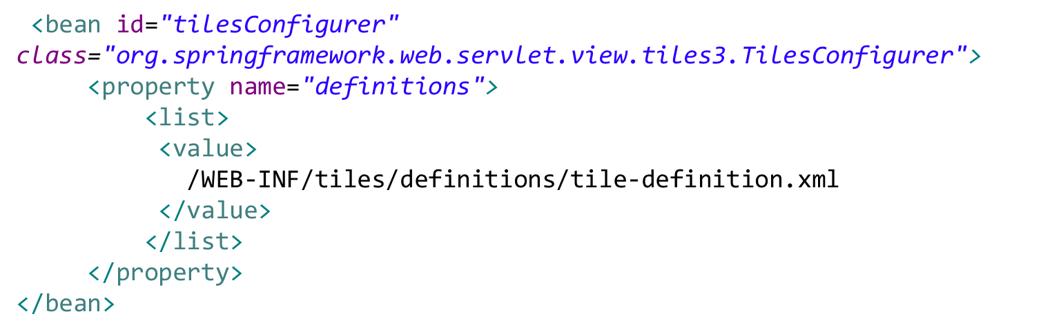
Tiles Configuration
<bean id="tilesViewResolver"
class="org.springframework.web.servlet.view.UrlBasedViewResolver">
<property name="viewClass"
value="org.springframework.web.servlet.view.tiles3.TilesView" />
<property name="order" value="-2" />
</bean>

Slide 27
Tiles Configuration(Java Config)
@Configuration
@EnableWebMvc
@ComponentScan("edu.mum.cs")
public class WebApplicationContextConfig extends WebMvcConfigurerAdapter {
  @Bean
  public TilesConfigurer tilesConfigurer() {
    TilesConfigurer tilesConfigurer = new TilesConfigurer();
    tilesConfigurer.setDefinitions(new String[] { "/WEB-INF/views/**/tiles.xml" });
    tilesConfigurer.setCheckRefresh(true);
    return tilesConfigurer;
  }
  @Override
  public void configureViewResolvers(ViewResolverRegistry registry) {
    TilesViewResolver viewResolver = new TilesViewResolver();
    registry.viewResolver(viewResolver);
  }
}

Slide 28
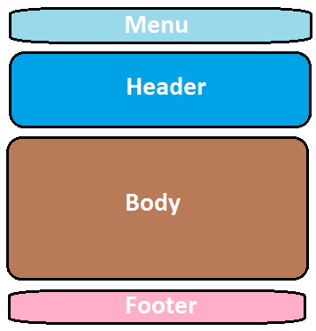
Sample Template [layoutTemplate.jsp ]
<title><tiles:insertAttribute name="title" /> <body>
<ul class="nav nav-pills pull-right">
<tiles:insertAttribute name="menu" />
</ul>
<h3 class="text-muted">Web Store</h3>
<h1>
<tiles:insertAttribute name="header" />
</h1>
<p>
<tiles:insertAttribute name="subHeader" />
</p>
<div class="row">
<tiles:insertAttribute name="body" />
</div>
<div class="footer">
<tiles:insertAttribute name="footer" />
</div>
</body>

Slide 29
Example Tiles Definition File [tiles.xml]
<tiles-definitions>
<!-- Template Definition -->
<definition name="template-def"
template="/WEB-INF/views/tiles/layouts/defaultLayout.jsp">
<put-attribute name="title" value="" />
<put-attribute name="header" value="/WEB-INF/views/tiles/templates/header.jsp" />
<put-attribute name="menu" value="/WEB-INF/views/tiles/templates/menu.jsp" />
<put-attribute name="body" value="" />
<put-attribute name="footer" value="/WEB-INF/views/tiles/templates/footer.jsp" />
</definition>
</tiles-definitions>

Slide 30
Example Tiles Pages [tiles.xml]
<!-- Main Page -->
<definition name="myhome" extends="template-def">
<put-attribute name="title" value="Welcome" />
<put-attribute name="body" value="/WEB-INF/views/pages/home.jsp" />
</definition>
<!-- User Page -->
<definition name="user" extends="template-def">
<put-attribute name="title" value="User" />
<put-attribute name="body" value="/WEB-INF/views/pages/user.jsp" />
</definition>
<!-- Admin Page -->
<definition name="admin" extends="template-def">
<put-attribute name="title" value="Admin" />
<put-attribute name="body" value="/WEB-INF/views/pages/admin.jsp" />
</definition>

Slide 31
Tiles: Wildcard
<bean id="tilesConfigurer"
class="org.springframework.web.servlet.view.tiles3.TilesConfigurer">
  <property name="definitions">
  <list><value>/WEB-INF/views/**/tiles.xml</value></list>
  </property>
  <property name="completeAutoload" value="true" />
</bean>
tiles.xml
<definition name="WILDCARD:user/*" extends="template-def">
<put-attribute name="title" value="{1}" />
<put-attribute name="body" value="/WEB-INF/views/pages/{1}.jsp" />
</definition>

Slide 32
Main Point
A well-defined exception and error handling approach is important for simplifying the development of web applications.
The removal of obstacles is an important aspect of the process of evolution.

